Slide 1

IE 260 – ENGINEERING ECONOMY Chapter 5 Evaluating a Single Project
U. MAHİR YILDIRIM

Slide 2
Chapter 5
The objective of Chapter 5 is to discuss and critique contemporary methods for determining project profitability
After working through this chapter, you will be able to evaluate the economic trade-off between alternatives.

Slide 3
Introduction
All engineering economy studies of capital projects should consider the return that a given project will or should produce.
“Does a proposed capital investment and its associated expenditures can be recovered by revenue (or savings) over time ?”
The interest and money–time relationships previously discussed emerge as essential ingredients in answering this question, and they are applied to many different types of problems in this chapter.

Slide 4
Introduction (cont’d)
Because patterns of capital investment, revenue (or savings) cash flows, and expense cash flows can be quite different in various projects, there is no single method for performing engineering economic analyses that is ideal for all cases. Consequently, several methods are commonly used.

Slide 5
Introduction (cont’d)
Proposed capital projects can be evaluated in several ways
Present worth (PW)
Future worth (FW)
Annual worth (AW)
Internal rate of return (IRR)
Payback period
generally not appropriate as a primary decision rule
often used to supplement information produced by the above five primary methods
Finding P
Finding F
Finding A

Slide 6
Determining the Minimum Attractive Rate of Return (MARR)
To be attractive, a capital project must provide a return that exceeds a minimum level established by the organization.
This minimum level is reflected in a firm’s Minimum Attractive Rate of Return (MARR). (Hurdle rate)
minimum return the company will accept on the money it invests
The MARR is usually calculated by financial analysts in the company and provided to those who evaluate the projects.

Slide 7
MARR
MARR is usually determined considering :
The source and cost of the funds and their relative composition
Borrowed Money : f (interest rates)
Equity: Driven by shareholders expected return on business. f(interest rates;market risk;project risk).
The amount of perceived risk associated with different investment opportunities
The estimated time horizon of the projects: short vs long term horizon
The amount of money available for investment : As Money needs increase cost may increase
The number of good projects available for investment and their purpose:
sustain present operations and are essential, or
expand on present operations and are elective

Slide 8
Sample Problem for Project Evaluation Methods
Cost/Revenue Estimates – Initial investment : $50,000 – Annual revenues : $20,000 – Annual operating costs : $2,500 – Salvage value at EOY 5 : $10,000 – Study period : 5 years – MARR : 10% / year
End Of Year

Slide 9
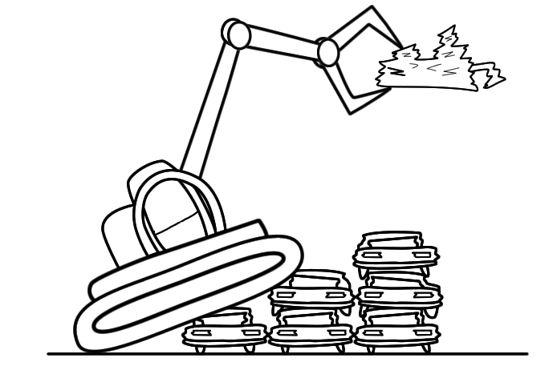
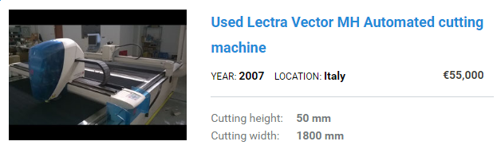
Salvage Value
Salvage value is the estimated resale or scrap value of an asset at the end of its useful life.
resale value
scrap value

Slide 10
Sample Problem for Project Evaluation Methods
Can be combined as a single cash flow of $30,000
Cost/Revenue Estimates – Initial investment : $50,000 – Annual revenues : $20,000 – Annual operating costs : $2,500 – Salvage value at EOY 5 : $10,000 – Study period : 5 years – MARR : 10% / year
$20,000
$20,000
$20,000
$20,000
$20,000
$10,000
CASH FLOW ?
0
1
2
3
4
5
$2,500
$2,500
$2,500
$2,500
$2,500
$50,000

Slide 11
The Present Worth (PW) Method
The PW method is based on the concept of equivalent worth of all cash flows relative to some base or beginning point in time called the present.
Compute the present equivalent of the estimated cash flows using the MARR as the interest rate. • If PW(MARR) ≥ 0, then the project is profitable. • If PW(MARR) < 0, then the project is not profitable.

Slide 12
PW for Sample Problem
$17,500
$17,500
$17,500
$17,500
$17,500
$30,000
$20,000
$20,000
$20,000
$20,000
CASH FLOW ?
0
1
2
+
3
4
5
≈
$10,000
CASH FLOW ?
CASH FLOW ?
0
1
2
3
4
5
0
1
2
3
4
5
$2,500
$2,500
$2,500
$2,500
$2,500
+
$50,000
CASH FLOW ?
0
1
2
3
4
5
$50,000

Slide 13
PW for Sample Problem
= (20,000-2,500))(P/A,10%,5)
$17,500
$17,500
$17,500
$17,500
$17,500
PW(10%)
= ?
CASH FLOW ?
+
0
1
2
+
3
4
5
$10,000
10,000(P/F, 10%, 5)
CASH FLOW ?
0
1
2
3
4
5
+
+
-50,000
CASH FLOW ?
0
1
2
3
4
5
$50,000

Slide 14
PW for Sample Problem
PW(10%) = $22,548
$17,500
$17,500
$17,500
$17,500
$17,500
CASH FLOW ?
0
1
2
+
3
4
5
$10,000
Since PW(10%) ≥ 0, the project is profitable
CASH FLOW ?
0
1
2
3
4
5
+
CASH FLOW ?
0
1
2
3
4
5
$50,000

Slide 15
Example
Consider a project that has an initial investment of $60,000 and that returns $18,000 per year for the next four years. If the MARR is 15%, is this a good investment?
PW = -60,000 + 18,000 (P/A, 15%, 4) PW = -60,000 + 18,000 (2.8550) PW = $-8,610 → This is a not good investment!

Slide 16
Underlying Assumptions of PW method and other cash flow based methods
That we know the future with certainty: We don’t live in a certain world! – We presume also to know with certainty future interest rates and other factors.
It is assumed we can borrow and lend money at the same interest rate: – (i.e. capital markets are perfect).
All cashflows at any time can and will be reinvested at the MARR
Regrettably, the real world has neither certainty nor perfect (frictionless, e.g., no taxes and/or commissions) capital markets.
But it is cost-beneficial in the sense that the cost of using the PW model is less than the benefits of improved decisions resulting from PW analysis. More sophisticated models exist, but they usually do not reverse decisions made with the PW model

Slide 17
The Future Worth (FW) Method
An alternative to the PW method
Looking at FW is appropriate since the primary objective is to maximize the future wealth of owners of the firm.
FW is based on the equivalent worth of all cash inflows and outflows at the end of the study period at an interest rate that is generally the MARR.
Decisions made using FW vs decisions made using PW ?
they will be the same.

Slide 18
FW for Sample Problem
FW(10%)
= -50,000(F/P, 10%, 5)
+ (20,000-2,500))(F/A, 10%, 5)
+10,000
= $36,314.25
= ?
$30,000
$20,000
$20,000
$20,000
$20,000
Since FW(10%) ≥ 0, the project is profitable
CASH FLOW ?
0
1
2
3
4
5
$2,500
$2,500
$2,500
$2,500
$2,500
$50,000

Slide 19
PW vs FW
FW
PW
0
1
2
3
4
5

Slide 20
Example FW
A $45,000 investment in a new conveyor system is projected to improve throughput and increase revenue by $14,000 per year for five years. The conveyor will have an estimated market value of $4,000 at the end of five years. Using FW and a MARR of 8%, is this a good investment?
FW = -$45,000(F/P, 8%, 5)+$14,000(F/A, 8%, 5)+$4,000
FW = -$45,000(1.4693)+$14,000(5.8666)+$4,000
FW = $20,013.90 → This is a good investment!

Slide 21
The Annual Worth (AW) Method
An equal periodic series of dollar amounts that is equivalent to the cash inflows and outflows, at an interest rate that is generally the MARR.
The AW of a project is annual equivalent revenue or savings (R) minus annual equivalent expenses (E), less its annual capital recovery (CR) amount.
AW(i%) = R - E - CR(i%)
Notes:
another way to assess projects

Slide 22
Capital Recovery (CR)
CR is the annual equivalent cost of the capital invested.
The CR covers the following items. – Loss in value of the asset. – Interest on invested capital (at the MARR).
The CR distributes the initial cost (I) and the salvage value (S) across the life of the asset.

Slide 23
Capital Recovery
CR(i%) = I(A/P, i%, N) - S(A/F, i%, N)
where I = initial investment for the project; S = salvage (market) value at the end of the study period; N = project study period.

Slide 24
Example Capital Recovery
Consider a device that will cost $10,000, last five years, and have a salvage (market) value of $2,000.
Thus, the loss in value of this asset over five years is ?
Additionally, the MARR is 10% per year.
Recall CR(i%) = I(A/P, i%, N) - S(A/F, i%, N)
CR(10%) = $10,000(A/P, 10%, 5) – $2,000(A/F, 10%, 5)
= $2,310.4
$8,000.

Slide 25
The Annual Worth (AW)
AW(i%) = R - E - CR(i%)
&
CR(i%) = I(A/P, i%, N) - S(A/F, i%, N)
AW(i%) = R - E - I(A/P, i%, N) + S(A/F, i%, N)
revenue or savings
annual equivalent expenses

Slide 26
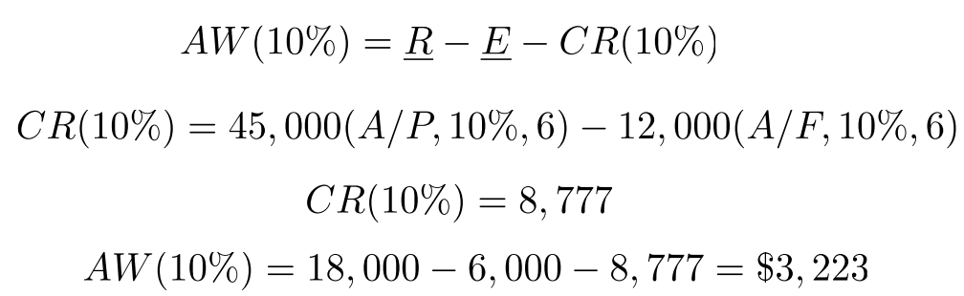

Example AW Calculation
A project requires an initial investment of $45,000, has a salvage value of $12,000 after six years, incurs annual expenses of $6,000, and provides an annual revenue of $18,000. Using a MARR of 10%, determine the AW of this project.

Slide 27
Example Equivalent Uniform Annual Cost of a Corporate Jet
A corporate jet costs $1,350,000 and will incur $200,000 per year in fixed costs (maintenance, licenses, insurance, and hangar rental) and $277 per hour in variable costs (fuel, pilot expense, etc.). The jet will be operated for 1,200 hours per year for five years and then sold for $650,000. The MARR is 15% per year.
(a) Determine the capital recovery cost of the jet. (b) What is the EUAC of the jet?

Slide 28

EUAC = Equivalent Uniform Annual Cost
Annual equivalent of the sum of the costs and CR

Slide 29
Example Equivalent Uniform Annual Cost of a Corporate Jet
A corporate jet costs $1,350,000 and will incur $200,000 per year in fixed costs (maintenance, licenses, insurance, and hangar rental) and $277 per hour in variable costs (fuel, pilot expense, etc.). The jet will be operated for 1,200 hours per year for five years and then sold for $650,000. The MARR is 15% per year.
(a) Determine the capital recovery cost of the jet.
CR(i%) = I(A/P, i%, N) - S(A/F, i%, N)
(b) What is the EUAC of the jet?
Equivalent Uniform Annual Cost (Annual equivalent of the sum of the costs and CR)

Slide 30
Solution Equivalent Uniform Annual Cost of a Corporate Jet
CR = $1,350,000 (A/P, 15%, 5) - $650,000 (A/F, 15%, 5) = $306,310.
The total annual expense for the jet is the sum of the fixed costs and the variable costs.
E = $200,000 + (1,200 hours)($277/hour) = $532,400
EUAC(15%) = $532,400 + $306,310 = $838,710

Slide 31
AW vs PW and FW
The AW of a project is equivalent to its PW and FW
AW = PW(A/P, i%, N)
AW = FW(A/F, i%, N)
Many decision makers prefer the AW method because it is relatively easy to interpret when they are accustomed to working with annual income statements and cash-flow summaries.

Slide 32
Recall
Proposed capital projects can be evaluated in several ways
Present worth (PW)
Future worth (FW)
Annual worth (AW)
Internal rate of return (IRR)
Payback period
generally not appropriate as a primary decision rule
often used to supplement information produced by the above five primary methods
Finding P
Finding F
Finding A

Slide 33
The Internal Rate of Return (IRR) Method
This method solves for the interest rate that equates the equivalent worth of an alternative’s cash inflows (receipts or savings) to the equivalent worth of cash outflows (expenditures, including investment costs).
Equivalent worth may be computed using any of the three methods discussed earlier.
The resultant interest rate is termed the Internal Rate of Return (IRR). The IRR is sometimes referred to as the breakeven interest rate.

Slide 34
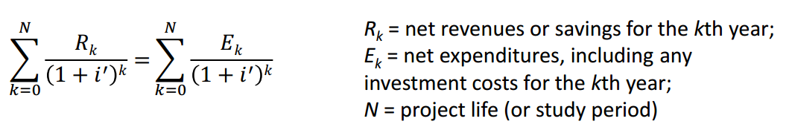
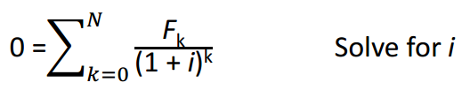
IRR (cont’d)
Solve for i’ which will be the Internal rate of return (of the project). Solution through iterative procedure
IRR Decision Rule: If IRR ≥ MARR, the project is economically justified
Alternative formulation : IRR is the rate at which Net Present worth is equal to 0

Slide 35
IRR – Be Careful!
For a single alternative, from the lender’s viewpoint, the IRR is not positive unless
both receipts and expenses are present in the cash-flow pattern, and
the sum of receipts exceeds the sum of all cash outflows.
Be sure to check both of these conditions in order to avoid the unnecessary work involved in finding that the IRR is negative. (Visual inspection of the total net cash flow will determine whether the IRR is zero or less.)

Slide 36
Example Recall our Sample Problem
Cost/Revenue Estimates – Initial investment : $50,000 – Annual revenues : $20,000 – Annual operating costs : $2,500 – Salvage value at EOY 5 : $10,000 – Study period : 5 years – MARR : 10% / year
$30,000
$20,000
$20,000
$20,000
$20,000
CASH FLOW ?
0
1
2
3
4
5
$2,500
$2,500
$2,500
$2,500
$2,500
$50,000

Slide 37
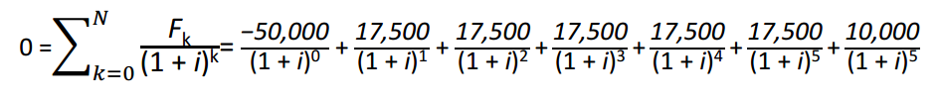
Solution Recall our Sample Problem
To solve for i we can use EXCEL’s IRR function =IRR(values; [guess])
Values Required. An array or a reference to cells that contain numbers for which you want to calculate the internal rate of return. Guess Optional. A number that you guess is close to the result of IRR.

Slide 38
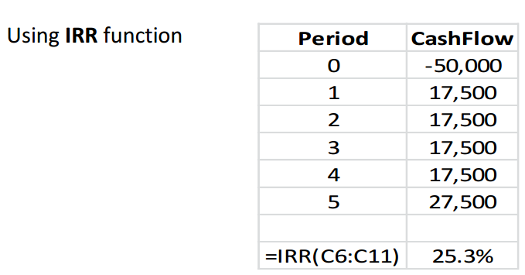
Solution Recall our Sample Problem
The IRR of 25.3% > MARR(10%) therefore project is acceptable

Slide 39
Solution by Linear Interpolation Recall our Sample Problem
What is the interest rate that makes the Present Worth (PW)=0 ?
This interest rate is IRR
PW = 0 = -$50,000 + ($17,500)(P/A, i′%, 5) + $10,000(P/F, i′%, 5)
i′% = IRR = ?

Slide 40
Solution by Linear Interpolation Recall our Sample Problem
To use linear interpolation, we first need to try a few values for i′.
A good starting point is to use the MARR.
At i′ = 10%:
PW = -$50,000 + ($17,500)(P/A, 10%, 5) + $10,000(P/F, 10%, 5) = $22,548
Since the PW is positive at 10%, we know that i′ > 10%.
Let's try i′ = 30% arbitrarily:
PW = -$50,000 + ($17,500)(P/A, 30%, 5) + $10,000(P/F, 30%, 5) = - $4,677

Slide 41
Solution by Linear Interpolation Recall our Sample Problem
Now that we have both a positive and a negative PW, the answer is bracketed in interval 10% ≤ IRR ≤ 30%
IRR ≈ 26.56%
10%
PW = $22,548
IRR
PW = $0
IRR – 10%
$22,548 – $0
=
30% – 10%
$22,548–(–$4,677)
30%
PW = - $4,677

Slide 42
Solution by Linear Interpolation Recall our Sample Problem
IRR ≈ 26.56%
Because the IRR of the project (26.56 %) is greater than the MARR (10%), the project is acceptable.
Note the IRR we calculated in Excel. As the interval in linear interpolation increases, the deviation increases as well.

Slide 43
Solution by Linear Interpolation Recall our Sample Problem
What if we tried 20% instead of 30% ?
PW = -$50,000 + ($17,500)(P/A, 20%, 5) + $10,000(P/F, 20%, 5) = $6,341.5
Note that both of the PW values are positive.

Slide 44
Solution by Linear Interpolation Recall our Sample Problem
10%
PW = $22,548
20% – 10%
$22,548 – $6,341.5
=
IRR – 10%
$22,548 – $0
20%
PW = $6,341.5
IRR
PW = $0
IRR ≈ 23.91%

Slide 45
Example Economic Desirability of a Project Using the IRR Method
AMT, Inc., is considering the purchase of a digital camera for the maintenance of design specifications by feeding digital pictures directly into an engineering workstation where computer-aided design files can be superimposed over the digital pictures. Differences between the two images can be noted, and corrections, as appropriate, can then be made by design engineers. The capital investment requirement is $345,000 and the estimated market value of the system after a six-year study period is $115,000. Annual revenues attributable to the new camera system will be $120,000, whereas additional annual expenses will be $22,000. You have been asked by management to determine the IRR of this project and to make a recommendation. The corporation’s MARR is 20% per year. Solve first by using linear interpolation and then by using a spreadsheet.

Slide 46
Solution by Linear Interpolation Economic Desirability of a Project Using the IRR Method
The sum of positive cash flows ($835,000) exceeds the sum of negative cash flows ($455,000). Thus, it is likely that positive valued IRR can be determined.
PW = 0 = -$345,000 + ($120,000 - $22,000)(P/A, i′%, 6) + $115,000(P/F, i′%, 6)
i′% = ?

Slide 47
Solution by Linear Interpolation Economic Desirability of a Project Using the IRR Method
To use linear interpolation, we first need to try a few values for i′.
A good starting point is to use the MARR.
At i′ = 20%:
PW = -$345,000 + $98,000(3.3255) + $115,000(0.3349) = +$19,413
Since the PW is positive at 20%, we know that i′ > 20%.
At i′ = 25%:
PW = -$345,000 + $98,000(2.9514) + $115,000(0.2621) = -$25,621

Slide 48

Solution by Linear Interpolation Economic Desirability of a Project Using the IRR Method
Now that we have both a positive and a negative PW, the answer is bracketed (20% ≤ i′% ≤ 25%).
i′ ≈ 22.16%
Because the IRR of the project (22.16%) is greater than the MARR, the project is acceptable.

Slide 49
The Payback (Payout) Period
The payback method calculates the number of years required for cash inflows to just equal cash outflows, without taking into consideration time value of money.
All methods presented thus far reflect the profitability of a proposed alternative for a study period of N.
The payback method, which is often called the simple payout method, mainly indicates a project’s liquidity rather than its profitability, since liquidity deals with how fast an investment can be recovered

Slide 50
The Payback (Payout) Period (cont’d)
The payback period does not indicate anything about project desirability except the speed with which the investment will be recovered.
The payback period can produce misleading results, and it is recommended as supplemental information only in conjunction with one or more of the five methods previously discussed.

Slide 51
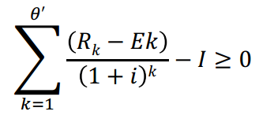
Discounted Payback Period
Sometimes, the discounted payback period, θ′(θ′ ≤ N), is calculated so that the time value of money is considered. In this case
Where i% is the MARR, I is the capital investment usually made at the present time (k = 0), and θ′ is the smallest value that satisfies the above equation.

Slide 52
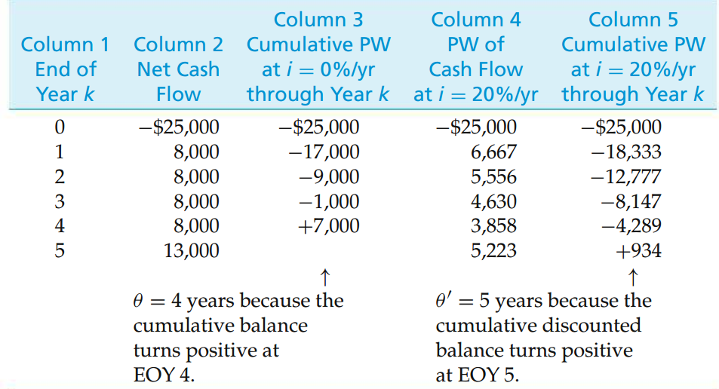
Example Payback Period

Slide 53
End of Chapter 5

